Slide 1


Weather Station
PROJECT
DHRUVBHATTACHARJEE
NITIN MISRA
Mentor : Charanpreet Ma’am
Project Teacher : Mohit Sir
18BCS2072
18BCS1988

Slide 2
INTRODUCTION:
The use of IOT devices in our present generation can be seen almost everywhere. This project takes the use of IOT and its features to predict weather using data from a database which further includes past readings and Humidity around it. It also uses other products which will be talked about in the upcoming slides.

Slide 3
RESOURCES:
Hardware requirements:
• Arduino Uno
• DHT11 Temperature and Humidity sensor
• Raindrop detection sensor
• ESP8266 WIFI module
• GSM module for Arduino
• Internet enabled WIFI connection
• Computer (programming Arduino)
Software requirements:
• Window/Linux/Mac OS
• Arduino IDE
• Python
• Eclipse mosquitto
• MongoDB
• Google cloud services

Slide 4
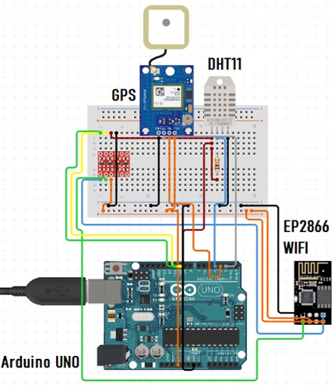
CIRCUIT:
The components of the circuit given are as follows:
DHT11 as the main sensor
WIFI Module
Arduino UNO
Raindrop sensor

Slide 5
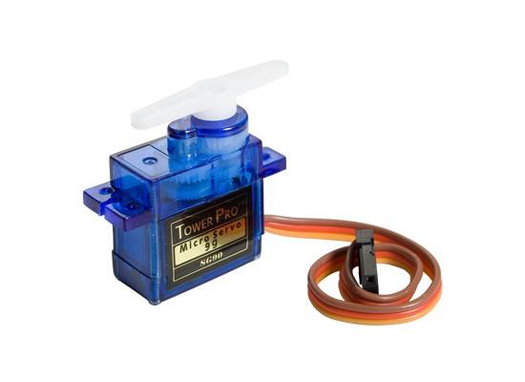
Servo Motor
A Servo Motor is a small device that has an output shaft. This shaft can be positioned to specific angular positions by sending the servo a coded signal.
As long as the coded signal exists on the input line, the servo will maintain the angular position of the shaft.

Slide 6
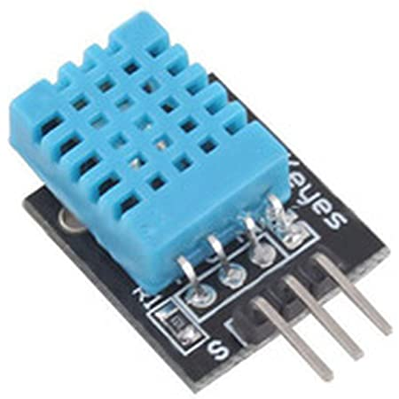
DHT11 as the main sensor
This is Temperature and Humidity Sensor used to detect the temperature and humidity in specific area where installed.
This will send the readings as and when asked or called.
Applications:
Measure temperature and humidity
Local Weather station
Automatic climate control
Environment monitoring

Slide 7
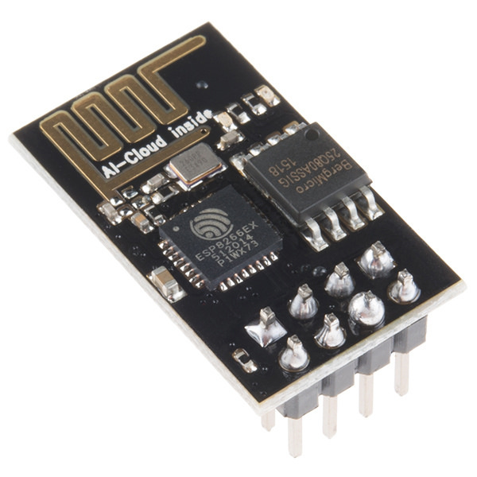
WIFI MODULE
The Wi-Fi Micro chip is used to Connect to the network near by.
It then connects to the database and the software and helps in recording the data formed by the readings.
The Wi-Fi module used in the project is ESP8266 and is a low cost microchip with a full TCP/IP stack and microcontroller capability.
The ESP8285 is an ESP8266 with 1 MiB of built-in flash, allowing the building of single-chip devices capable of connecting to Wi-Fi.

Slide 8
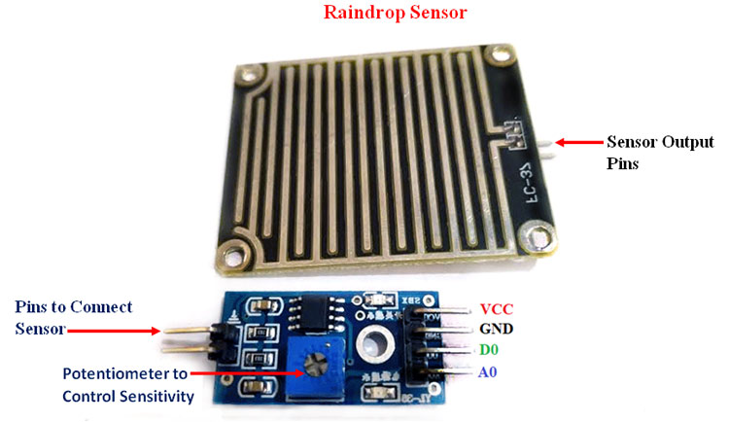
RAINDROP SENSOR
Raindrop Sensor is a tool used for sensing rain. It consists of two modules, a rain board that detects the rain and a control module, which compares the analogue value, and converts it to a digital value.
The raindrop sensors can be used in the automobile sector to control the windshield wipers automatically, in the agriculture sector to sense rain and it is also used in home automation systems.

Slide 9
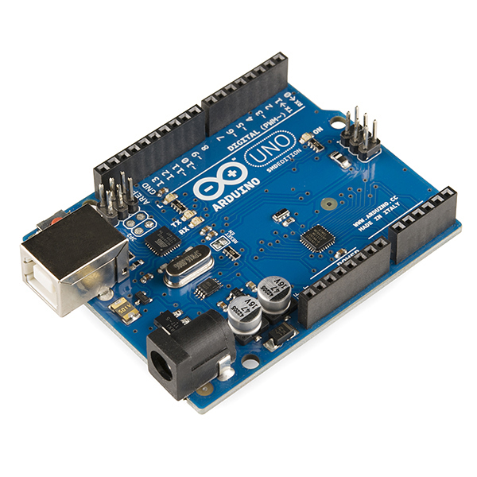
ADRUINO UNO
Arduino is an open-source hardware and software company, project and user community that designs and manufactures single-board microcontrollers and microcontroller kits for building digital devices.
This will be used to trigger and use the different components.
Just like IOT, such a main device will be used to activate and bring in use the other components connected to it.

Slide 10
SOFTWARE AND BACKEND control
The main Programming part is to be implemented for and on the Arduino as the main device.
The frontend As mentioned before we use Adruino IDE as the corntol center for themain IoT device Aduino.
The Backend used in this is mongoDB. MongoDB is a source-available cross-platform document-oriented database program. It stores and helps to provide data for the prediction of the weather.
One more front end part that can be termed as the User interface will be managed by Eclipse mosquito. It will be used to show the readings.
Following are the Screenshots of the control centre for the project

Slide 11
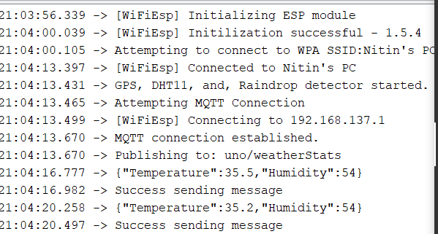
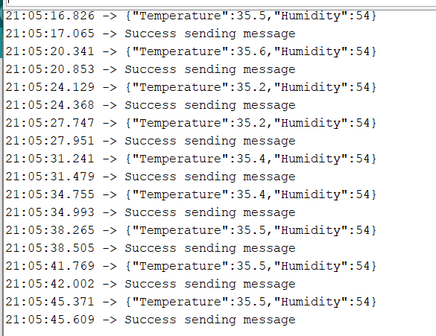
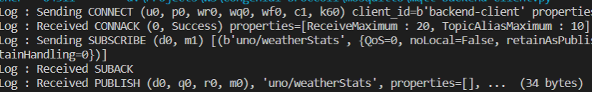
Wi-Fi connection with mosquitto

Slide 12
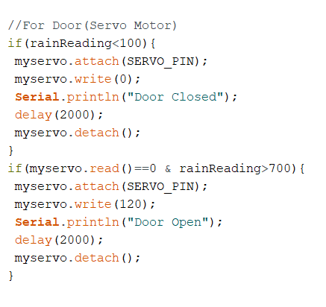
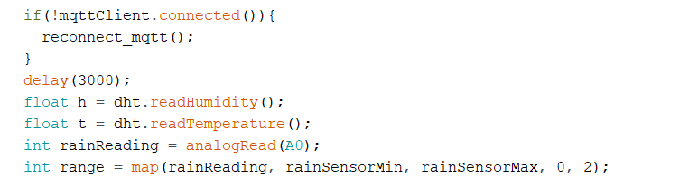
Code work for connection of The Rain drop sensor and DHT11

Slide 13
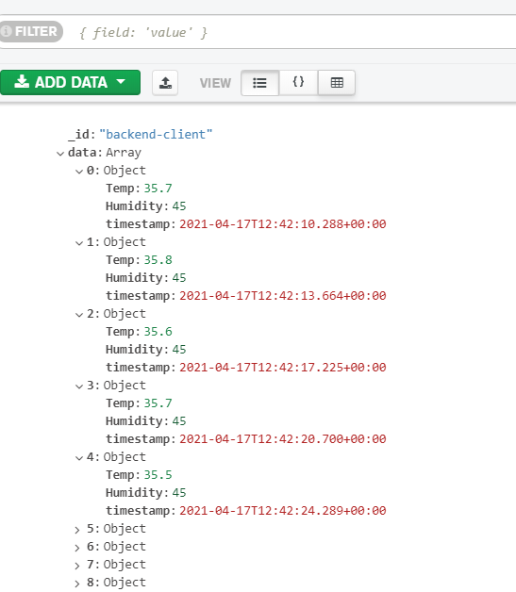
DATA BASE Mongo DB interface

Slide 14
Contribution
Nitin Mishra (18BCS1988)
Arduino design and database management
Working on MQTT and mosquitto
Dhruv Bhattacharjee
Idea Generation and future work frontend development

Slide 15
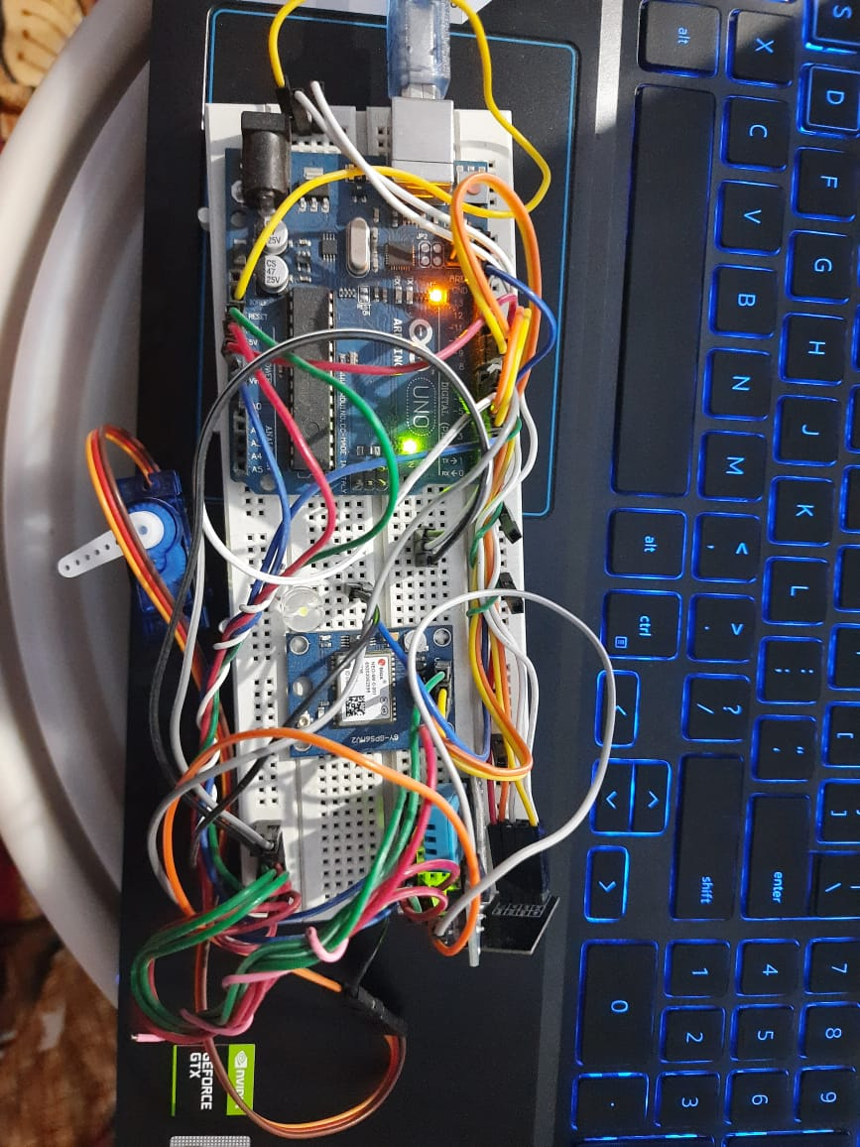
The final Circuit :

Slide 16
THANK YOU

